Slide 1
SQL Profiler
Day 5 - Chapter 1

Slide 2
SQL Profiler
It is used to capture Database events and save them
These events or workload later can be feed in to SQL Advisor
SQL Advisor will suggest tips for performance tuning based up on workload trace
Tools to benchmark database
https://www.brentozar.com/archive/2008/09/finding-your-san-bottlenecks-with-sqlio/
https://dba.stackexchange.com/questions/74971/how-to-benchmark-microsoft-sql-server
Execution plan basics and sample database (adventureworks)
https://www.simple-talk.com/sql/performance/execution-plan-basics/
http://www.codeplex.com/MSFTDBProdSamples

Slide 3
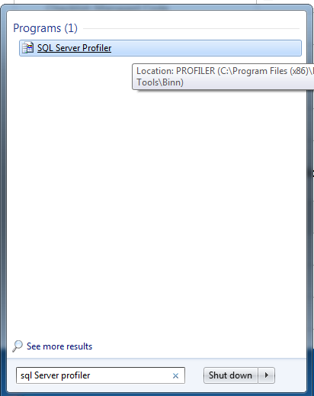
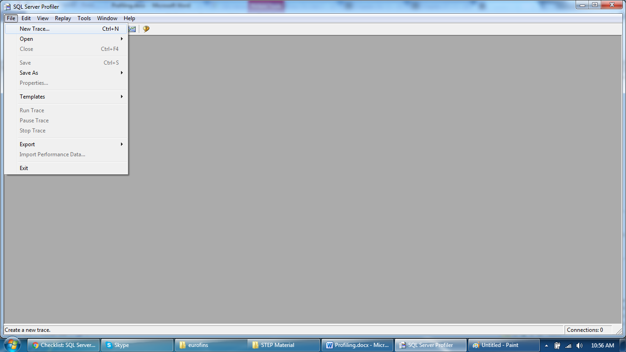
SQL Profiler
Open a New Trace in SQL Profiler

Slide 4
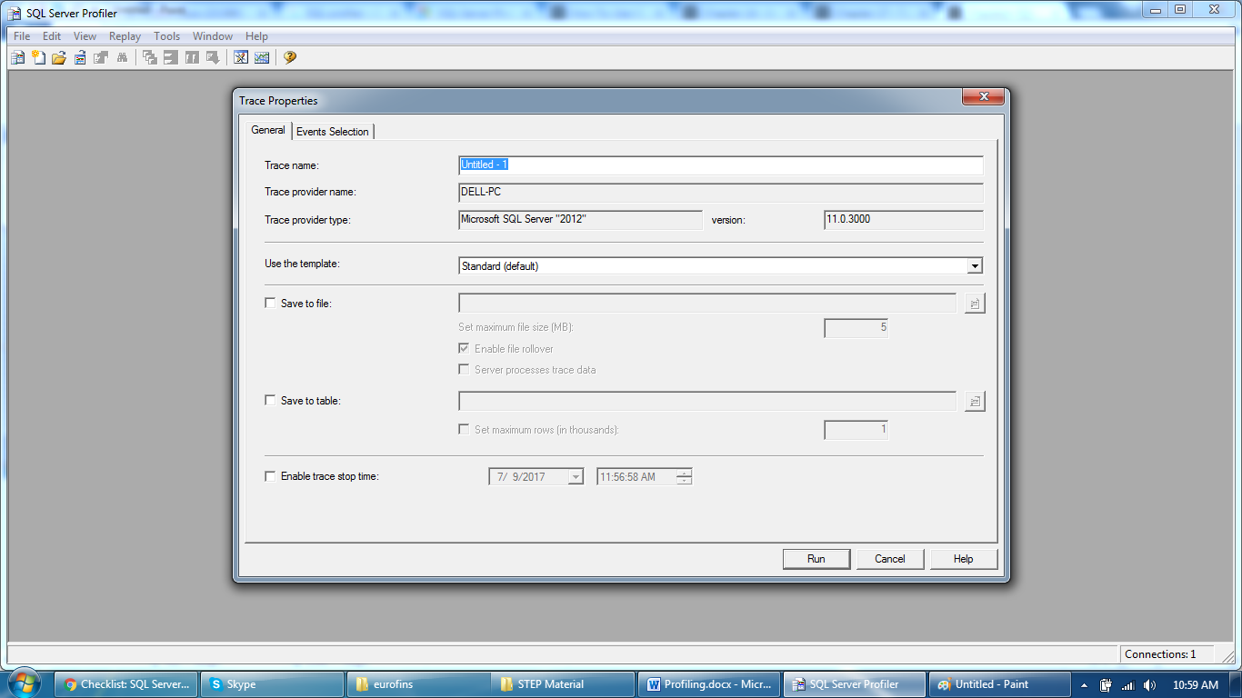
SQL Profiler
Provide a Template, server name and trace name

Slide 5
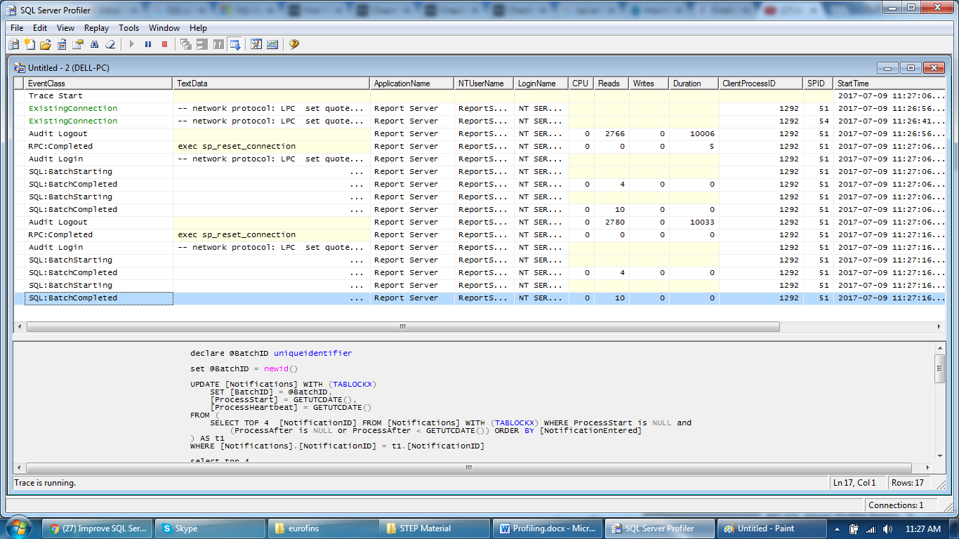
SQL Profiler
Traces will be visible based up on filters applied or template

Slide 6
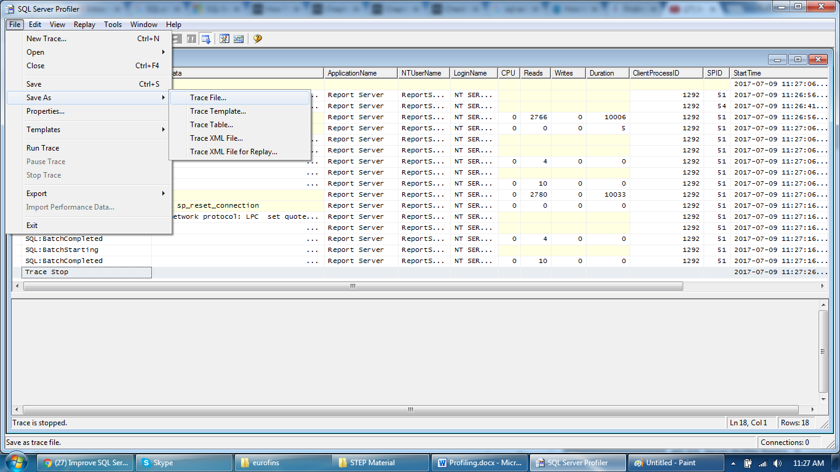
SQL Profiler
Save a trace file

Slide 7
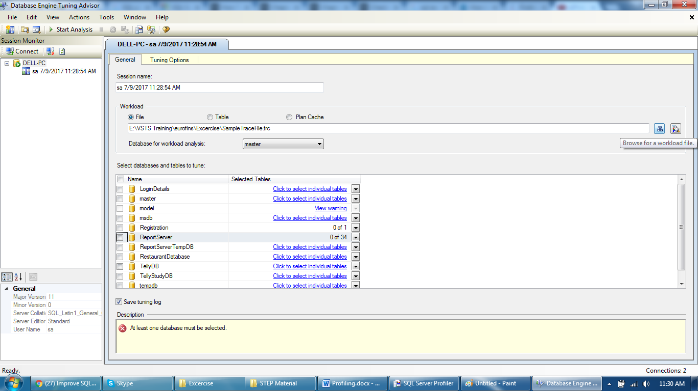
SQL Profiler
Open a Database Engine Tuning Advisor and open recent trace

Slide 8
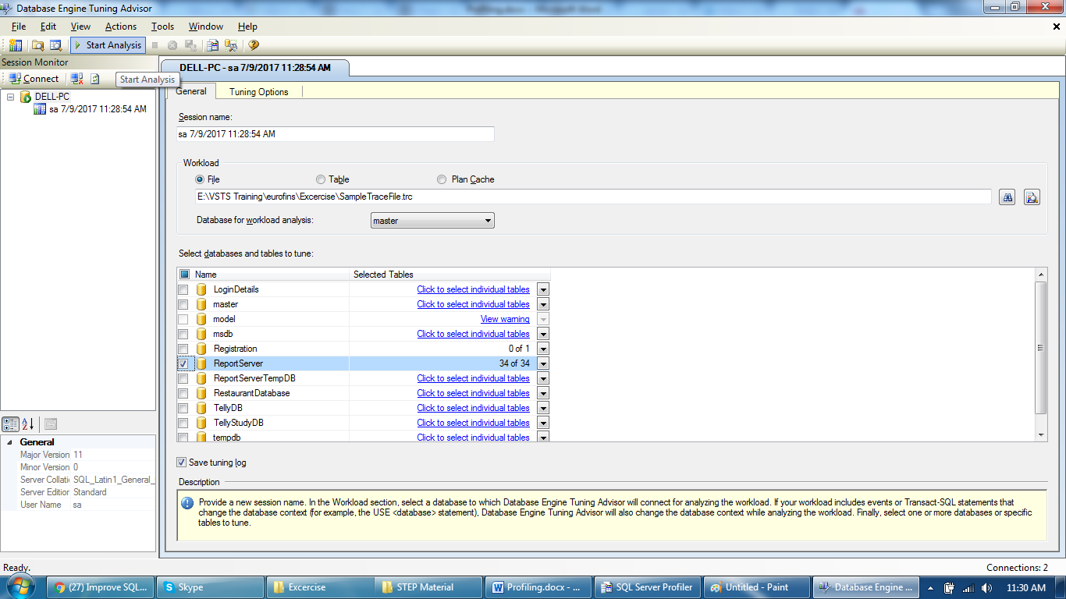
SQL Profiler
Start analysis

Slide 9
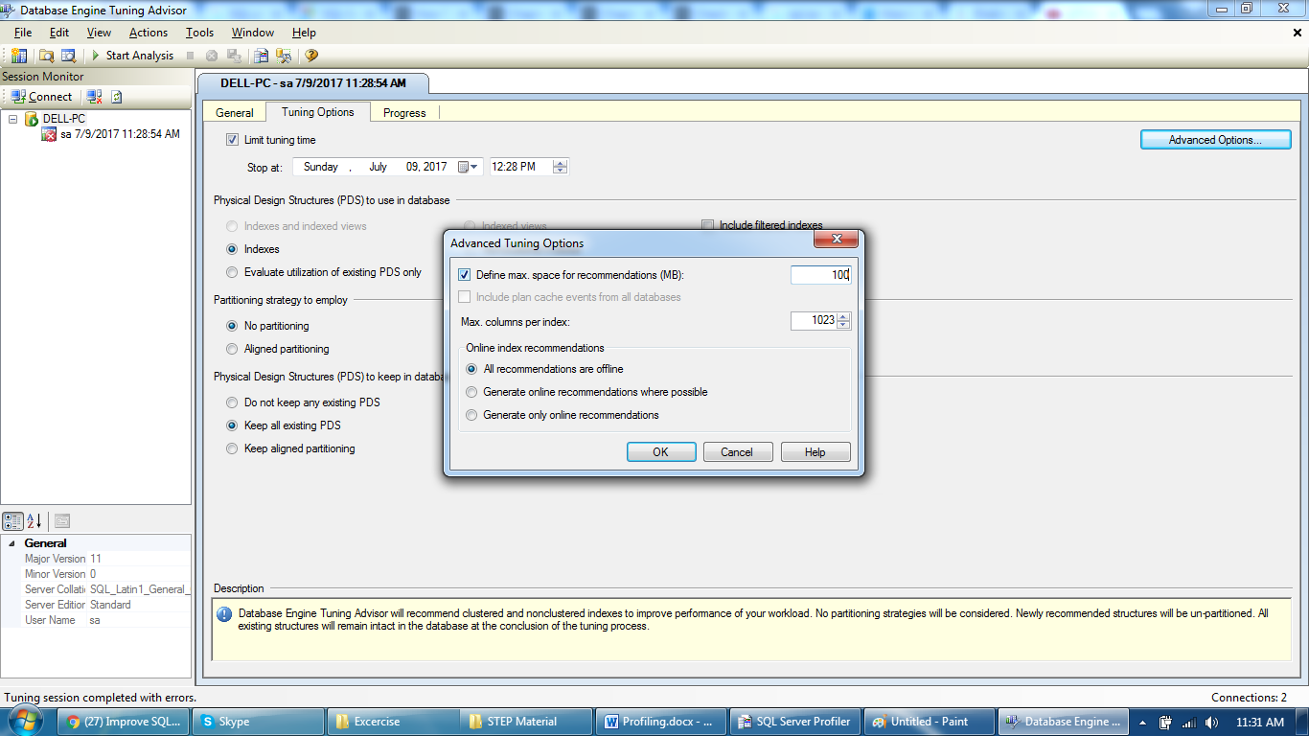
SQL Profiler
Provide some space to run a analysis

Slide 10
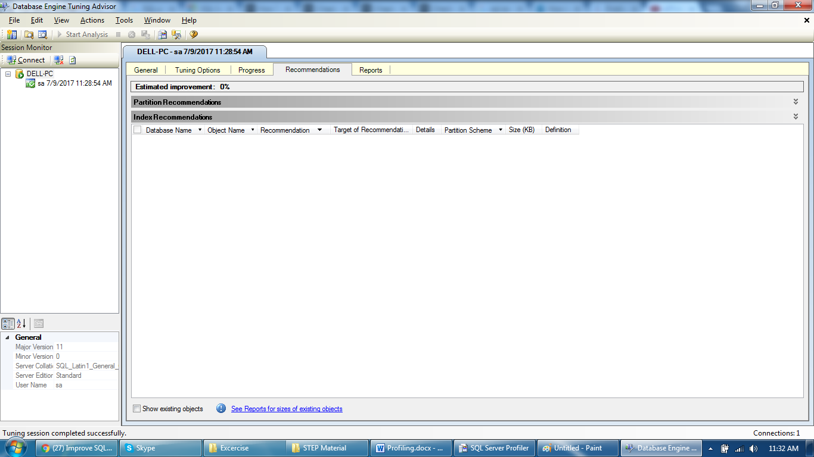
SQL Profiler
Recommendations and Reasons will be available

Slide 11
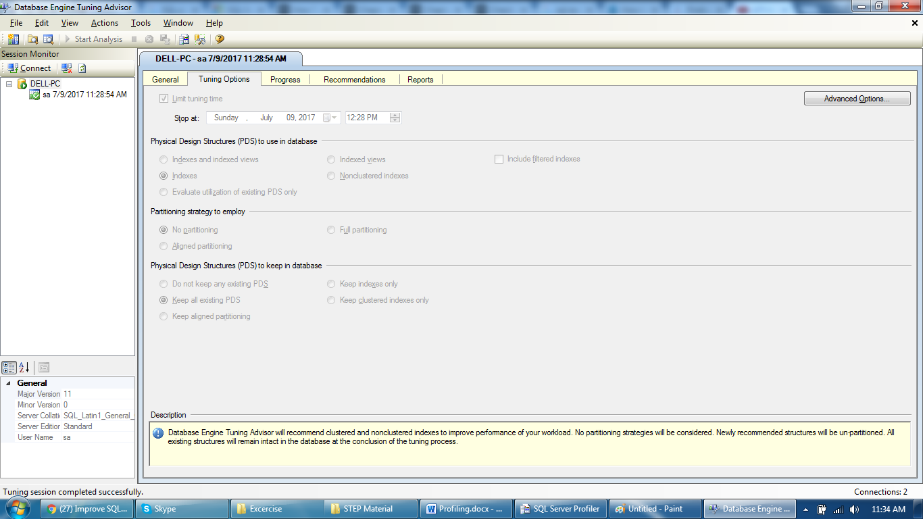
SQL Profiler
Additional options like Tuning options or Reports for next steps

Slide 12
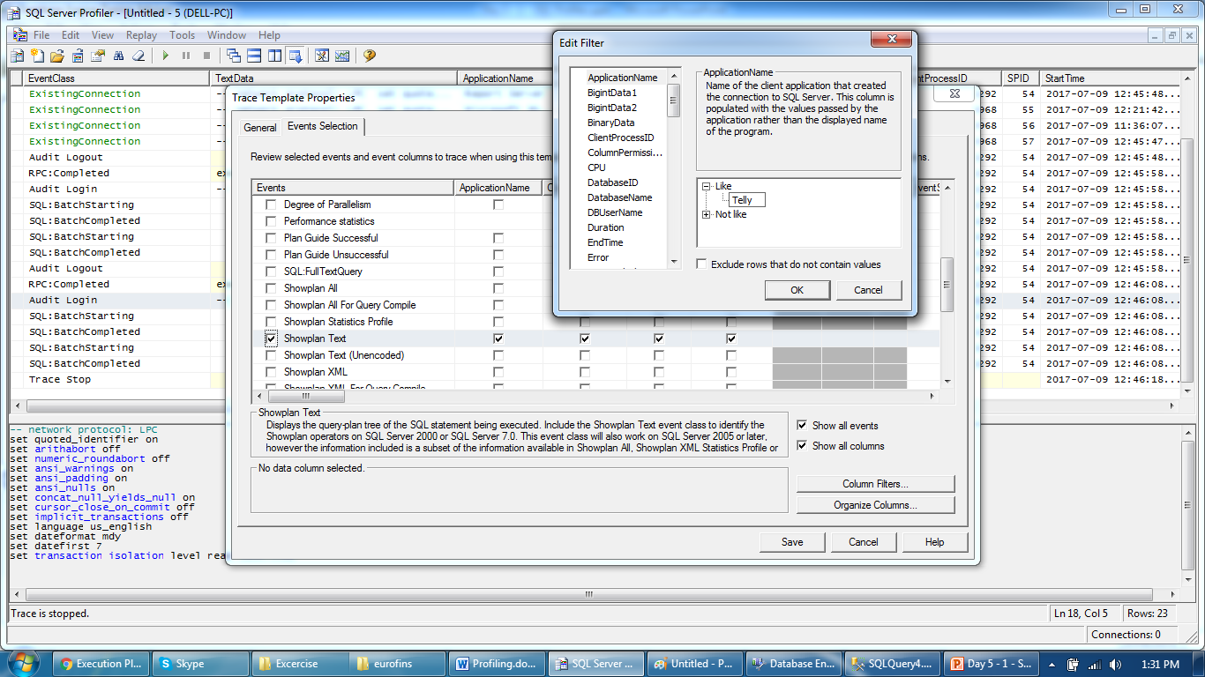
SQL Profiler
Execution plan can be saved and filter applied in a template

Slide 13
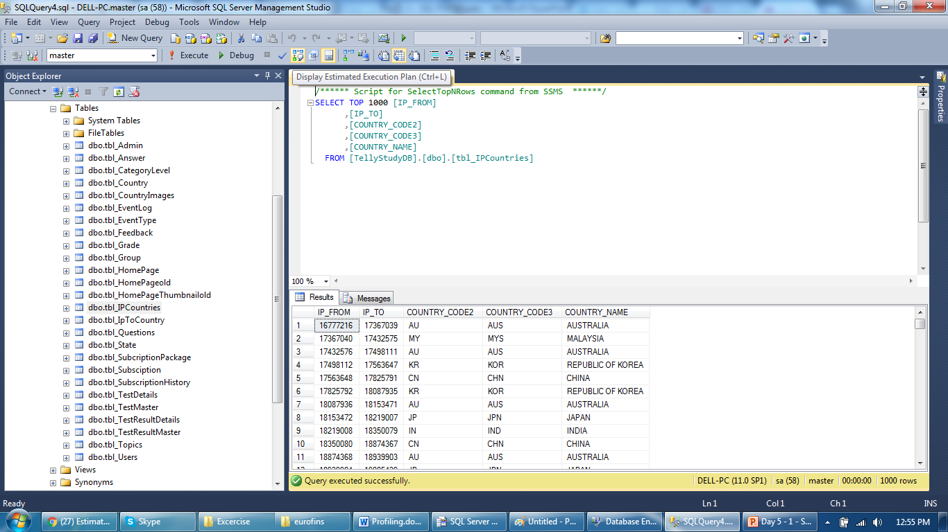
SQL Query Execution Plan
Select a query and click on “display estimated execution plan”

Slide 14
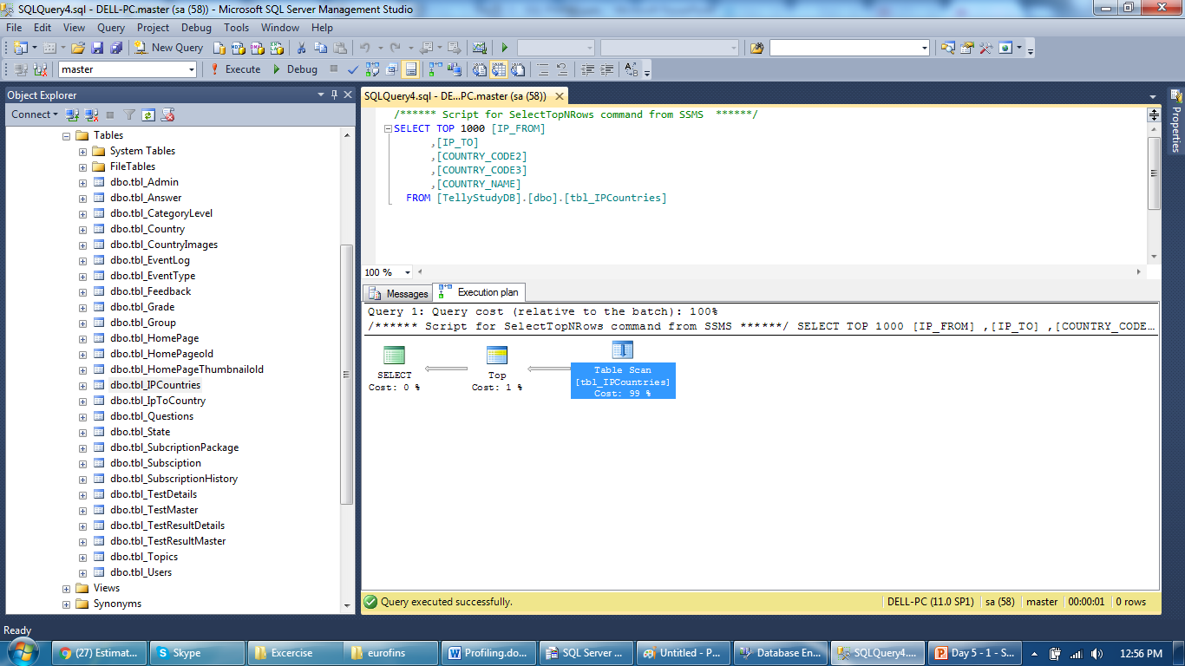
SQL Query Execution Plan
It will provide breakdown and execution plan details

Slide 15
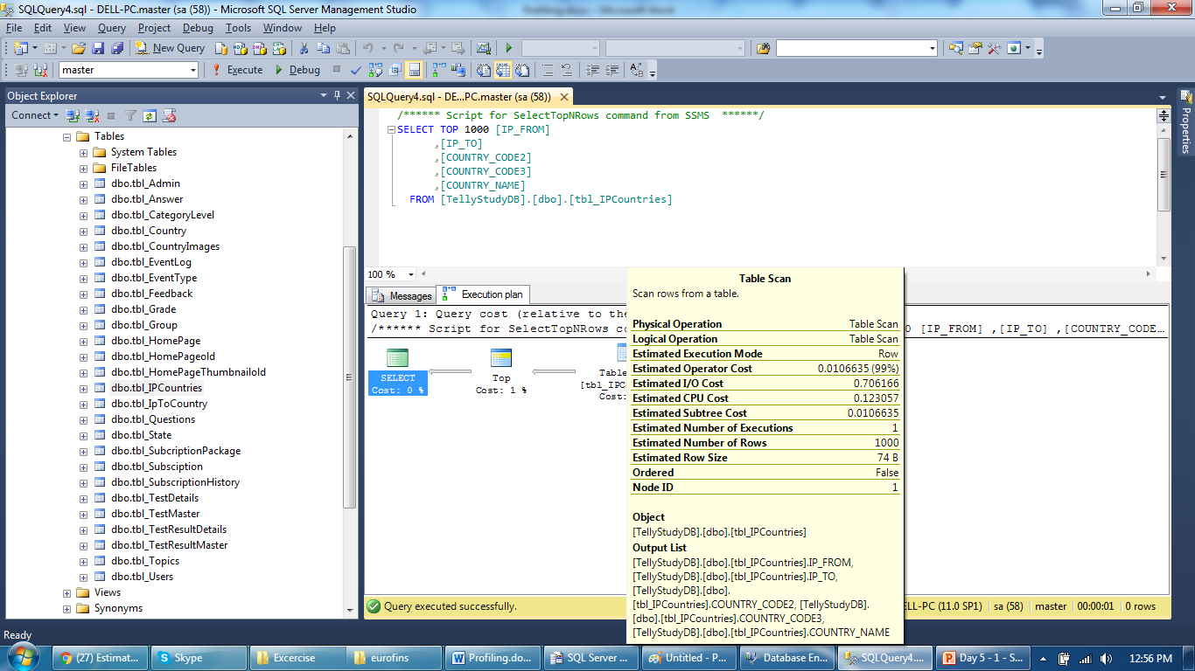
SQL Query Execution Plan
Physical operation and logical operation are in sync

Slide 16
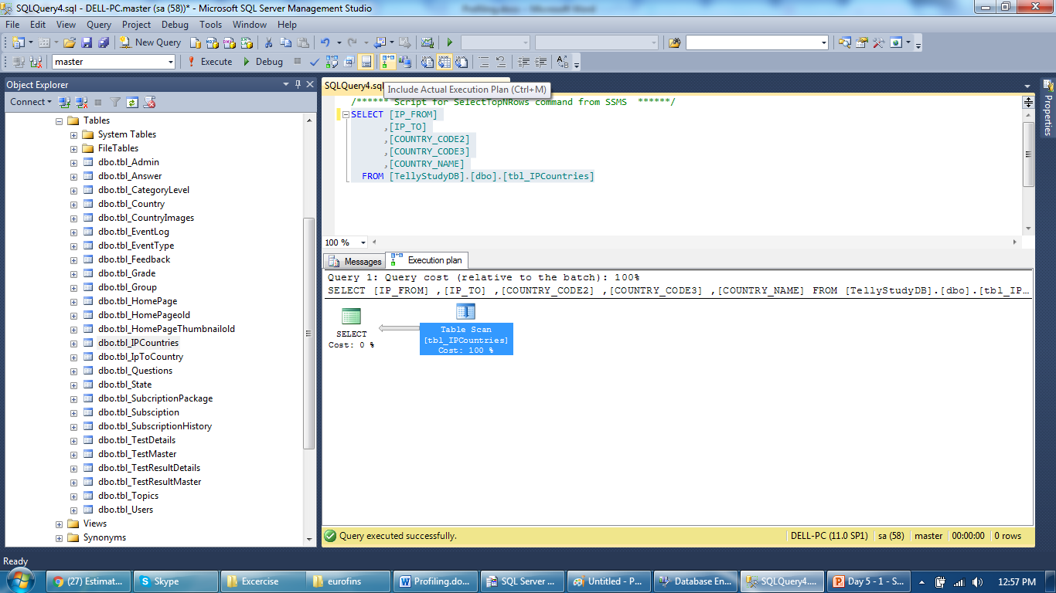
SQL Query Execution Plan
Check “Include Actual Execution Plan” and Client statistics

Slide 17
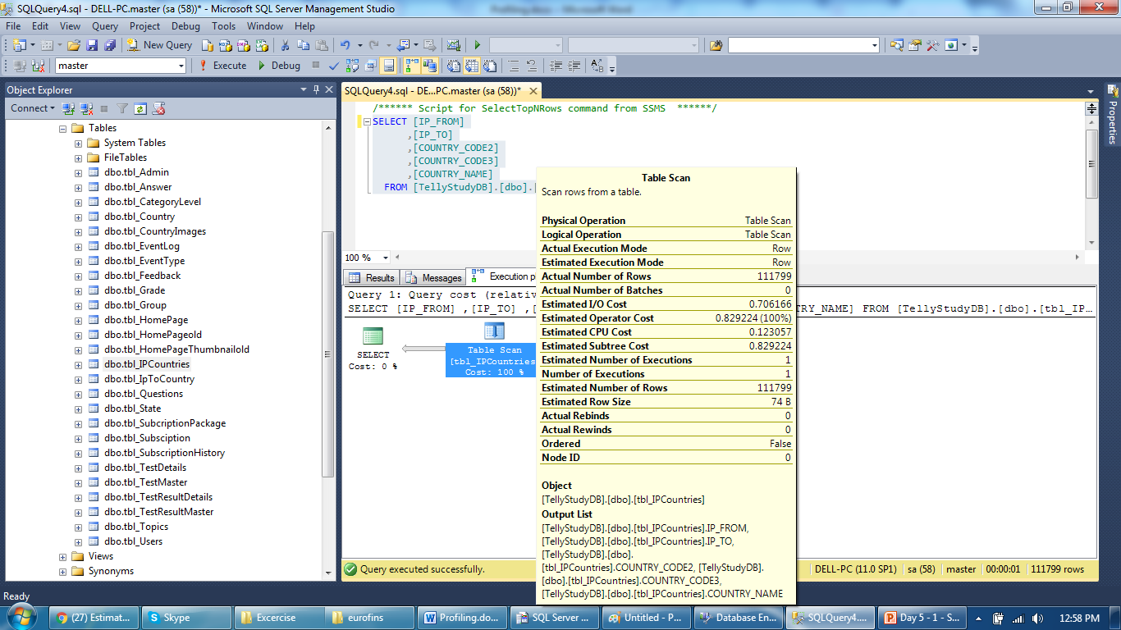
SQL Query Execution Plan
Compare actual execution plan with the estimated one

Slide 18
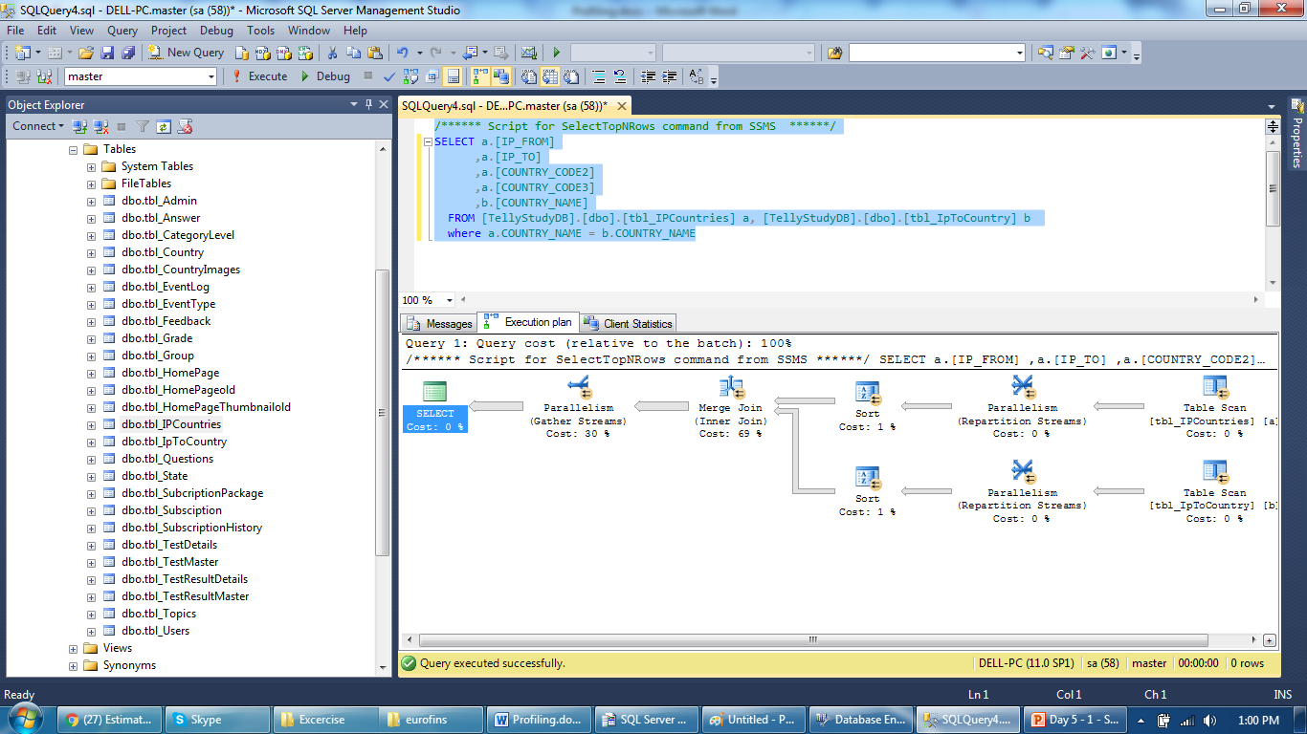
SQL Query Execution Plan
Get similar details but on a Join query

Slide 19
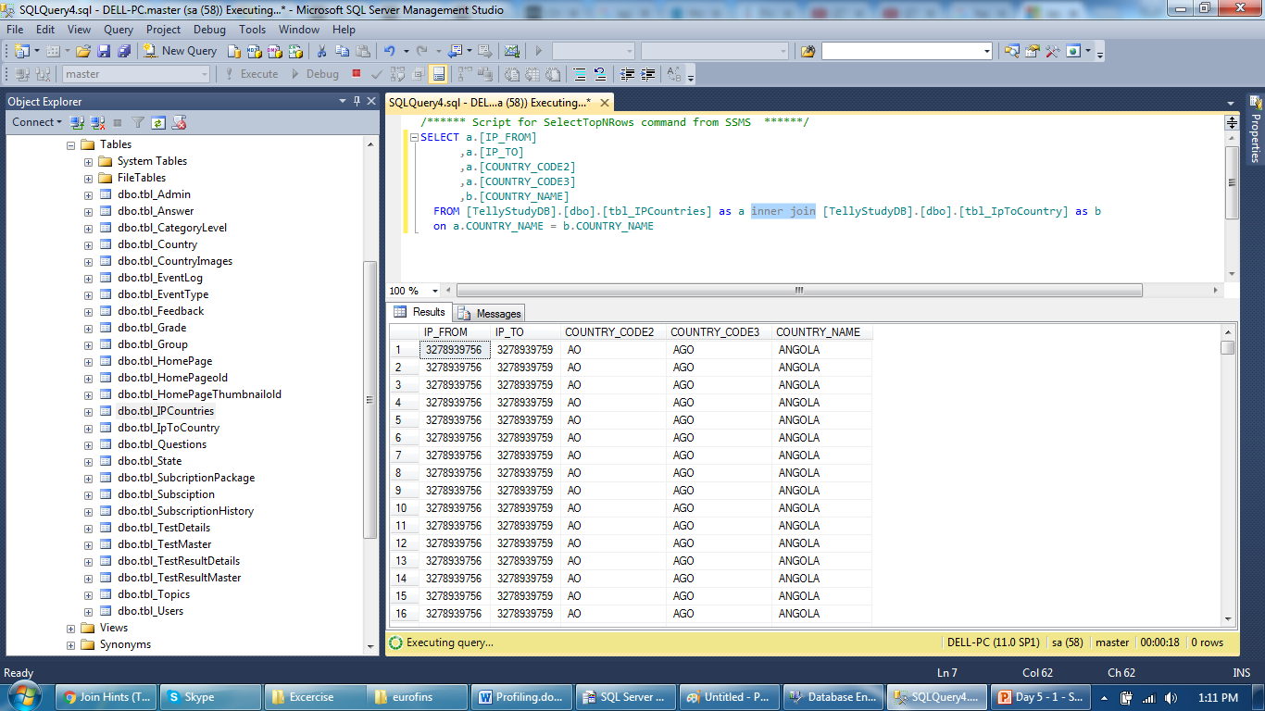
SQL Query Execution Plan
Provide a hint for a join and check execution plan

Slide 20
Thank You

